Slide 1
7/13/2019
Battle of Neighborhoods Report
Battle of Neighborhoods Coursera Project Report
Content 1.Introduction Section
Discussion of the "backgroung situation" leading to the problem at hand
Problem to be solved
Audience for this project
Data Section
Data of place to be compared with
Data required to solve the problem
How the data will be used to solve the problem
Mapping Data
Methodolgy Section
Process steps and strategy to resolve the problem
Data Science Methods, machine learning, mapping tools and exploratory data analysis
Results Section
Discussion of the results and how they help to take a decision 5.Discussion Section
Elaboration and discussion on any observations and/or recommendations for improvement 6.Conclusion Section
Desicison taken and Report Conclusion
1. Introduction Section
1.1 Scenario
How can I find a convenient and enjoyable place similar to one in Singapore? In order to make a comparison and evaluation of the rental options in Manhattan NY, I must set some basis, therefore the apartment in Manhattan must meet the following demands
apartment must be 2 or 3 bedrooms
desired location is near a metro station in the Manhattan area and within 1.0 mile (1.6 km) radius
price of rent should not exceed 7,000 dollars per month

Slide 2
7/13/2019
Battle of Neighborhoods Report
top ammenities in the selected neighborhood shall be similar to current residence
desirable to have venues such as coffee shops, restaurants Asian Thai, wine stores, gym and food shops
Problem to be solved
The challenge is to find a suitable apartment for rent in Manhattan NY that complies with the demands on location, price and venues.
Interested Audience
I believe this is a relevant challenge with valid questions for anyone moving to other large city in US, EU or Asia. The same methodology can be applied in accordance to demands as applicable. This case is also applicable for anyone interested in exploring starting or locating a new business in any city. Lastly, it can also serve as a good practical exercise to develop Data Science skills.
Data Section
Data of place to be compared with
I've picked the neighborhood of 'Mccallum Street' in Downtonw Singapore. I use Foursquare to identify the venues around the area of residence which are then shown in the Singapore map shown in methodology and execution in section 3.0 . It serves as a reference for comparison with the desired future location in Manhattan NY
Data required to solve the problem
The following data is required to answer the issues of the problem:
List of Boroughs and neighborhoods of Manhattan with their geodata (latitud and longitud) List of Subway metro stations in Manhattan with their address location
List of apartments for rent in Manhattan area with their addresses and price
Preferably, a list of apartment for rent with additional information, such as price, address, area, # of beds, etc
Venues for each Manhattan neighborhood ( than can be clustered) Venues for subway metro stations, as needed
2.3 How the data will be used to solve the problem
The data will be used as follows:

Slide 3
7/13/2019
Battle of Neighborhoods Report
Use Foursquare and geopy data to map top 10 venues for all Manhattan neighborhoods and clustered in groups
Use foursquare and geopy data to map the location of subway metro stations , separately and on top of the above clustered map in order to be able to identify the venues and ammenities near each metro station, or explore each subway location separately
Use Foursquare and geopy data to map the location of rental places, in some form, linked to the subway locations.
Create a map that depicts, for instance, the average rental price per square ft, around a radious of 1.0 mile around each subway station - or a similar metrics. I will be able to quickly point to the popups to know the relative price per subway area.
Addresses from rental locations will be converted to geodata using Geopy-distance and Nominatim.
Data will be searched in open data sources if available, from real estate sites if open to reading, libraries or other government agencies such as Metro New York MTA, etc.
2.4 Mapping Data
The following maps were created to facilitate the analysis and the choice of the palace to live.
Manhattan map of Neighborhoods manhattan subway metro locations Manhattan map of places for rent
Manhattan map of clustered venues and neighborhoods Combined maps of Manhattan rent places with subway locations
Combined maps of Manhattan rent places with subway locations and venues clusters
3. Methodology
3.1 Process steps and strategy to resolve the problem
The strategy is based on mapping the above described data in section 2.0, in order to facilitate the choice of at least two candidate places for rent. The choice is made based on the demands imposed : location near a subway, rental price and similar venues to Singapore. This visual approach and maps with popups labels allow quick identification of location, price and feature, thus making the selection very easy.
Answer the key questions to make a decision
what is the cost of rent (per square ft) around a mile radius from each subway metro station? what is the area of Manhattan with best rental pricing that meets criteria established?
what is the distance from work place ( assume: Park Ave and 53 rd St) and the tentative future home?
what are the venues of the two best places to live? How the prices compare?

Slide 4
7/13/2019
Battle of Neighborhoods Report
how venues distribute among Manhattan neighborhoods and around metro stations? are there tradeoffs between size and price and location?
any other interesting statistical data findings of the real estate and overall data?
3.2 Data Science Methods, machine learning, mapping tools and exploratory data analysis
In [2]:
import numpy as np
import time
import pandas as pd pd.set_option('display.max_columns', None) pd.set_option('display.max_rows', None)
import json
import requests
from pandas.io.json import json_normalize
from geopy.geocoders import Nominatim from geopy.exc import GeocoderTimedOut import folium
print('Libraries imported.')
Libraries imported.
In [3]:
address = 'Mccallum Street, Singapore'
geolocator = Nominatim()
location = geolocator.geocode(address, timeout=10) latitude = location.latitude
longitude = location.longitude
print('The geograpical coordinate of the place in Singapore are {}, {}.'.format(l
F:\Anaconda\lib\site-packages\ipykernel_launcher.py:3: DeprecationWarning: Usin g Nominatim with the default "geopy/1.20.0" `user_agent` is strongly discourage d, as it violates Nominatim's ToS https://operations.osmfoundation.org/policie s/nominatim/ (https://operations.osmfoundation.org/policies/nominatim/) and may possibly cause 403 and 429 HTTP errors. Please specify a custom `user_agent` wi th `Nominatim(user_agent="my-application")` or by overriding the default `user_ agent`: `geopy.geocoders.options.default_user_agent = "my-application"`. In geo py 2.0 this will become an exception.
This is separate from the ipykernel package so we can avoid doing imports unt il
The geograpical coordinate of the place in Singapore are 1.2792423, 103.848131 2.
In [4]:
neighborhood_latitude=1.2792423 neighborhood_longitude=103.8481312
Dial FourSquare to find venues around chosen neighborhood in Singapore

Slide 5
7/13/2019
Battle of Neighborhoods Report
In [5]:
CLIENT_ID="LUETHARMZN0ATS5LKT1YNTB2C5Y2MS42IUKEYIJ5JGN1NNJU" CLIENT_SECRET="4H4F054UDSZJ2EATK5DEMCMRPR3RNRCTXCZBCCCIELED3EZB" VERSION = '20180604'
LIMIT = 100
In [6]:
# define radius
radius = 500
# create URL
url = 'https://api.foursquare.com/v2/venues/explore?&client_id={}&client_secret={ CLIENT_ID,
CLIENT_SECRET, VERSION,
neighborhood_latitude, neighborhood_longitude, radius,
LIMIT)
# display URL
url
Out[6]:
'https://api.foursquare.com/v2/venues/explore?&client_id=LUETHARMZN0ATS5LKT1YNT B2C5Y2MS42IUKEYIJ5JGN1NNJU&client_secret=4H4F054UDSZJ2EATK5DEMCMRPR3RNRCTXCZBCC CIELED3EZB&v=20180604&ll=1.2792423,103.8481312&radius=500&limit=100'
In [7]:
results = requests.get(url).json()
Function that extracts the category of the venue - borrow from the Foursquare lab
In [8]:
# function that extracts the category of the venue
def get_category_type(row):
try:
categories_list = row['categories']
except:
categories_list = row['venue.categories']
if len(categories_list) == 0:
return None
else:
return categories_list[0]['name']

Slide 6
7/13/2019
Battle of Neighborhoods Report
In [9]:
venues = results['response']['groups'][0]['items']
SGnearby_venues = json_normalize(venues) # flatten JSON # filter columns
filtered_columns = ['venue.name', 'venue.categories', 'venue.location.lat', 'venu SGnearby_venues =SGnearby_venues.loc[:, filtered_columns]
# filter the category for each row
SGnearby_venues['venue.categories'] = SGnearby_venues.apply(get_category_type, ax
# clean columns
SGnearby_venues.columns = [col.split(".")[-1] for col in SGnearby_venues.columns]
# venues near chosen neighborhood in Singapore
SGnearby_venues.head(10)
Out[9]: | name | categories | lat | lng
 | 0 Napoleon Food & Wine Bar | Wine Bar | 1.279925 | 103.847333
 | 1 Pepper Bowl | Asian Restaurant | 1.279371 | 103.846710
 | 2 Native | Cocktail Bar | 1.280135 | 103.846844
 | 3 Park Bench Deli | Deli / Bodega | 1.279872 | 103.847287
 | 4 Freehouse | Beer Garden | 1.281254 | 103.848513
 | 5 Sofitel So Singapore | Hotel | 1.280124 | 103.849867
 | 6 Coffee Break | Coffee Shop | 1.279529 | 103.846695
 | 7 PS.Cafe | Café | 1.280468 | 103.846264
 | 8 Dumpling Darlings | Dumpling Restaurant | 1.280483 | 103.846942
 | 9 Nouri | Modern European Restaurant | 1.280267 | 103.846750
Map of Singapore with venues near residence place for reference

Slide 7
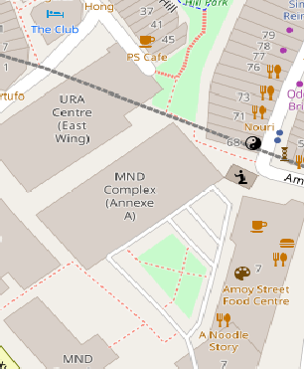
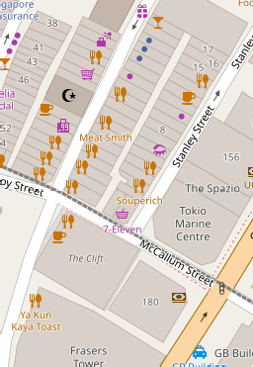


7/13/2019
Battle of Neighborhoods Report
In [10]:
# create map of Singapore place using latitude and longitude values
map_sg = folium.Map(location=[latitude, longitude], zoom_start=20)
# add markers to map
for lat, lng, label in zip(SGnearby_venues['lat'], SGnearby_venues['lng'], SGnear label = folium.Popup(label, parse_html=True)
folium.RegularPolygonMarker( [lat, lng], number_of_sides=4, radius=10,
popup=label, color='blue', fill_color='#0f0f0f', fill_opacity=0.7,
).add_to(map_sg)
map_sg
Out[10]:
+
−
Leaflet (http://leafletjs.com)
Cluster neighborhood data was produced with Foursquare during course lab work. A csv file was produced containing the neighborhoods around the 40 Boroughs. Now, the csv file is just read for convenience and consolidation of report.

Slide 8


7/13/2019
Battle of Neighborhoods Report
In [11]:
# Read csv file with clustered neighborhoods with geodata
manhattan_data = pd.read_csv('C:\Users\MUJ\Documents\Jupyter Notebooks\my_neighb manhattan_data.head()
Out[11]: | Borough | Neighborhood | Latitude | Longitude | Cluster Labels
 | 0 Manhattan | Marble Hill | 40.876551 | -73.910660 | 2
 | 1 Manhattan | Chinatown | 40.715618 | -73.994279 | 2
 | 2 Manhattan | Washington Heights | 40.851903 | -73.936900 | 4
 | 3 Manhattan | Inwood | 40.867684 | -73.921210 | 3
 | 4 Manhattan | Hamilton Heights | 40.823604 | -73.949688 | 0
In [12]:
manhattan_data.tail()
Out[12]: | Borough | Neighborhood | Latitude | Longitude | Cluster Labels
 | 35 Manhattan | Turtle Bay | 40.752042 | -73.967708 | 3
 | 36 Manhattan | Tudor City | 40.746917 | -73.971219 | 3
 | 37 Manhattan | Stuyvesant Town | 40.731000 | -73.974052 | 4
 | 38 Manhattan | Flatiron | 40.739673 | -73.990947 | 3
 | 39 Manhattan | Hudson Yards | 40.756658 | -74.000111 | 2
Manhattan Borough neighborhoods - data with top 10 clustered venues
In [13]:
manhattan_merged = pd.read_csv('C:\Users\MUJ\Documents\Jupyter Notebooks\merged.c manhattan_merged.head()
Out[13]:
2nd Most Common
Venue
Borough
Neighborhood
Latitude
Longitude
Cluster Labels
1st Most Common
Venue
3rd Most 4th
Common Co Venue
0
Manhattan
Marble Hill
40.876551 -73.910660
2
Coffee Shop
Discount
Store
Yoga Studio
Steak
1
Manhattan
Chinatown
40.715618 -73.994279
2
Chinese Restaurant
Cocktail
Bar
Dim Sum Am Restaurant Rest
2
Manhattan
Washington
Heights
40.851903 -73.936900
4
Café
Bakery
Mobile Phone Shop
Pizza
3
Manhattan
Inwood
40.867684 -73.921210
3
Mexican Restaurant
Lounge
Pizza Place
4
Manhattan
Hamilton Heights
40.823604 -73.949688
0
Mexican Restaurant
Coffee Shop
Café
B
popus allow to identify each neighborhood and the cluster of venues around it in order to

Slide 9
7/13/2019
Battle of Neighborhoods Report
proceed to examine in more detail in the next cell
In [14]:
import matplotlib.cm as cm
import matplotlib.colors as colors

Slide 10
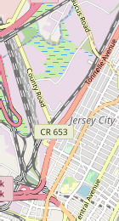
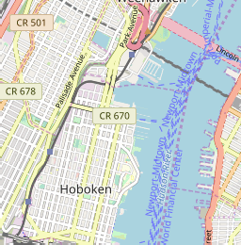
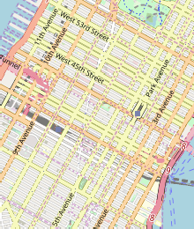

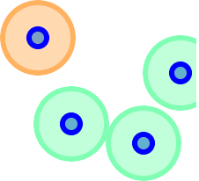
7/13/2019
Battle of Neighborhoods Report
In [15]:
# create map of Manhattan using latitude and longitude values from Nominatim
latitude= 40.7308619
longitude= -73.9871558
kclusters=5
map_clusters = folium.Map(location=[latitude, longitude], zoom_start=13)
# set color scheme for the clusters
x = np.arange(kclusters)
ys = [i+x+(i*x)**2 for i in range(kclusters)] colors_array = cm.rainbow(np.linspace(0, 1, len(ys))) rainbow = [colors.rgb2hex(i) for i in colors_array]
# add markers to the map
markers_colors = []
for lat, lon, poi, cluster in zip(manhattan_merged['Latitude'], manhattan_merged[ label = folium.Popup(str(poi) + ' Cluster ' + str(cluster), parse_html=True) folium.CircleMarker(
[lat, lon], radius=20, popup=label,
color=rainbow[cluster-1], fill=True, fill_color=rainbow[cluster-1],
fill_opacity=0.7).add_to(map_clusters)
# add markers for rental places to map
for lat, lng, label in zip(manhattan_data['Latitude'], manhattan_data['Longitude' label = folium.Popup(label, parse_html=True)
folium.CircleMarker( [lat, lng], radius=5, popup=label, color='blue', fill=True,
fill_color='#3186cc', fill_opacity=0.7, parse_html=False).add_to(map_clusters)
map_clusters
Out[15]:
+
−

Slide 11
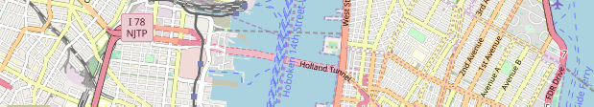


7/13/2019
Battle of Neighborhoods Report
Leaflet (http://leafletjs.com)
After examining several cluster data , I concluded that cluster # 2 resembles closer the Singapore place, therefore providing guidance as to where to look for the future apartment
In [16]:
## kk is the cluster number to explore
kk = 2
manhattan_merged.loc[manhattan_merged['Cluster Labels'] == kk, manhattan_merged.c
Out[16]:
 | 1st Most | 2nd Most | 3rd Most | 4th Most | 5th Most | 6th Most | 7th Mos
Neighborhood | Common | Common | Common | Common | Common | Common | Commo
 | Venue | Venue | Venue | Venue | Venue | Venue | Venu
0
Marble Hill
Coffee Shop
Discount
Store
Yoga Studio
Steakhouse
Supplement
Shop
Tennis Stadium
Sho Stor
1
Chinatown
Chinese Restaurant
Cocktail
Bar
Dim Sum Restaurant
American Restaurant
Vietnamese Restaurant
Salon / Barbershop
Noodl Hous
6
Central Harlem
African Restaurant
Seafood Restaurant
French Restaurant
American Restaurant
Cosmetics
Shop
Chinese Restaurant
Even Spac
9
Yorkville
Coffee Shop
Gym
Bar
Italian Restaurant
Sushi Restaurant
Pizza Place
Mexica Restauran
14
Clinton
Theater
Italian Restaurant
Coffee Shop
American Restaurant
Gym / Fitness Center
Hotel
Wine Sho
23
Soho
Clothing
Store
Boutique
Women's
Store
Shoe Store
Men's Store
Furniture /
Home Store
Italia Restauran
26
Morningside
Heights
Coffee Shop
American Restaurant
Park
Bookstore
Pizza Place
Sandwich
Place
Burge Join
34
Sutton Place
Gym / Fitness Center
Italian Restaurant
Furniture /
Home Store
Indian Restaurant
Dessert
Shop
American Restaurant
Baker
39
Hudson Yards
Coffee Shop
Italian Restaurant
Hotel
Theater
American Restaurant
Café
Gym Fitnes Cente
Several Manhattan real estate webs were webscrapped to collect rental data, as mentioned in section 2.0 . The resut was summarized in a csv file for direct reading, in order to consolidate the proces

Slide 12
7/13/2019
Battle of Neighborhoods Report
In [17]:
# csv files with rental places with basic data but still wihtout geodata ( latitu # pd.read_csv(' le.csv', header=None, nrows=5) mh_rent=pd.read_csv('C:\Users\MUJ\Documents\Jupyter Notebooks\manhattan_flats_pri mh_rent.head()
Out[17]: | Address | Area | Price_per_ft2 | Rooms | Area-ft2 | Rent_Price | Lat | Long
 | 0 West 105th Street | Upper West Side | 2.94 | 5 | 3400 | 10000 | NaN | NaN
 | 1 East 97th Street | Upper East Side | 3.57 | 3 | 2100 | 7500 | NaN | NaN
 | 2 West 105th Street | Upper West Side | 1.89 | 4 | 2800 | 5300 | NaN | NaN
 | 3 CARMINE ST. | West Village | 3.03 | 2 | 1650 | 5000 | NaN | NaN
 | 4 171 W 23RD ST. | Chelsea | 3.45 | 2 | 1450 | 5000 | NaN | NaN
Obtain geodata ( lat,long) for each rental place in Manhattan with Nominatim
In [ ]:
for n in range(len(mh_rent)): address= mh_rent['Address'][n]
address=(mh_rent['Address'][n]+ ' , '+' Manhattan NY ') geolocator = Nominatim()
location = geolocator.geocode(address) latitude = location.latitude longitude = location.longitude mh_rent['Lat'][n]=latitude mh_rent['Long'][n]=longitude #print(n,latitude,longitude) time.sleep(2)
print('Geodata completed')
# save dataframe to csv file
mh_rent.to_csv('manhattan_rent.csv',index=False)
In [19]:
mh_rent=pd.read_csv('C:\Users\MUJ\Documents\Jupyter Notebooks\manhattan_rent.csv' mh_rent.head()
Out[19]: |  | Address | Area
 | 0 | West 105th Street | Upper West Side
 | 1 | East 97th Street | Upper East Side
 | 2 | West 105th Street | Upper West Side
 | 3 | CARMINE ST. | West Village
Price_per_ft2 Rooms
Area-
Rent_Price
Lat
Long
 |  | ft2
2.94 | 5 | 3400 | 10000 | 40.799771 | -73.966213
3.57 | 3 | 2100 | 7500 | 40.788585 | -73.955277
1.89 | 4 | 2800 | 5300 | 40.799771 | -73.966213
3.03 | 2 | 1650 | 5000 | 40.730523 | -74.001873
3.45 | 2 | 1450 | 5000 | 40.744118 | -73.995299
4
171 W 23RD
ST.
Chelsea
Manhattan apartment rent price statistics

Slide 13
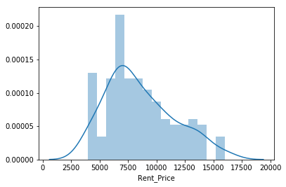
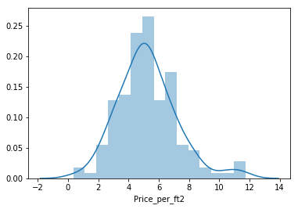
7/13/2019
Battle of Neighborhoods Report
In [20]:
import seaborn as sns
import matplotlib as plt
%matplotlib inline
In [21]:
sns.distplot(mh_rent['Rent_Price'],bins=15)
Out[21]:
<matplotlib.axes._subplots.AxesSubplot at 0xf6badd8>
In [37]:
import seaborn as sns sns.distplot(mh_rent['Price_per_ft2'],bins=15)
Out[37]:
<matplotlib.axes._subplots.AxesSubplot at 0xec9f908>
A US 7000 Dollar per month rent is actually around the mean value - similar to Singapore
The popups will indicate the address and the monthly price for rent thus making it convenient to select the target appartment with the price condition estipulated (max US7000) in Manhattan

Slide 14
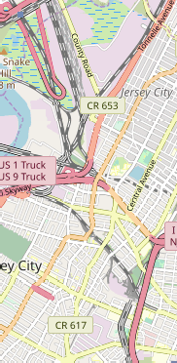
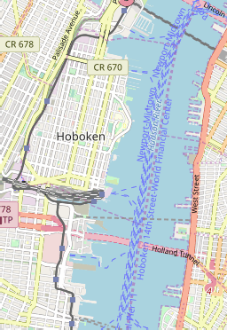
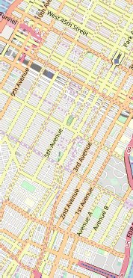





7/13/2019
Battle of Neighborhoods Report
In [22]:
# create map of Manhattan using latitude and longitude values from Nominatim
latitude= 40.7308619
longitude= -73.9871558
map_manhattan_rent = folium.Map(location=[latitude, longitude], zoom_start=12.5)
# add markers to map
for lat, lng, label in zip(mh_rent['Lat'], mh_rent['Long'],'$ ' + mh_rent['Rent_P label = folium.Popup(label, parse_html=True)
folium.CircleMarker( [lat, lng], radius=6, popup=label, color='blue', fill=True,
fill_color='#3186cc', fill_opacity=0.7,
parse_html=False).add_to(map_manhattan_rent)
map_manhattan_rent
Out[22]:
+
−
Leaflet (http://leafletjs.com)
Map of Manhattan showing the places for rent and the cluster of venues
Now, one can point to a rental place for price and address location information while knowing the cluster venues around it.

Slide 15

7/13/2019
Battle of Neighborhoods Report
In [23]:
# create map of Manhattan using latitude and longitude values from Nominatim
latitude= 40.7308619
longitude= -73.9871558
# create map with clusters
kclusters=5
map_clusters2 = folium.Map(location=[latitude, longitude], zoom_start=13)
# set color scheme for the clusters
x = np.arange(kclusters)
ys = [i+x+(i*x)**2 for i in range(kclusters)] colors_array = cm.rainbow(np.linspace(0, 1, len(ys))) rainbow = [colors.rgb2hex(i) for i in colors_array]
# add markers to the map
markers_colors = []
for lat, lon, poi, cluster in zip(manhattan_merged['Latitude'], manhattan_merged[ label = folium.Popup(str(poi) + ' Cluster ' + str(cluster), parse_html=True) folium.CircleMarker(
[lat, lon], radius=20, popup=label,
color=rainbow[cluster-1], fill=True, fill_color=rainbow[cluster-1],
fill_opacity=0.7).add_to(map_clusters2)
# add markers to map for rental places
for lat, lng, label in zip(mh_rent['Lat'], mh_rent['Long'],'$ ' + mh_rent['Rent_P label = folium.Popup(label, parse_html=True)
folium.CircleMarker( [lat, lng], radius=6, popup=label, color='blue', fill=True,
fill_color='#3186cc', fill_opacity=0.7,
parse_html=False).add_to(map_clusters2)
# Adds tool to the top right
from folium.plugins import MeasureControl map_manhattan_rent.add_child(MeasureControl())
# FMeasurement ruler icon to establish distnces on map
from folium.plugins import FloatImage
url = ('https://media.licdn.com/mpr/mpr/shrinknp_100_100/AAEAAQAAAAAAAAlgAAAAJGE3 FloatImage(url, bottom=5, left=85).add_to(map_manhattan_rent)
map_clusters2
Out[23]:
+
−

Slide 16
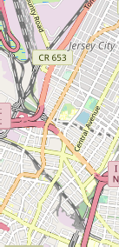
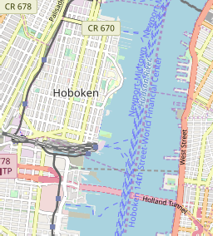
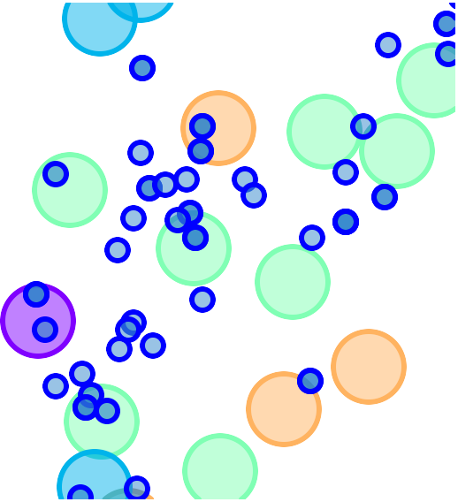
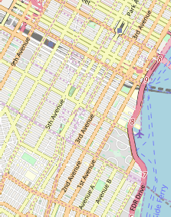
7/13/2019
Battle of Neighborhoods Report
Leaflet (http://leafletjs.com)
In the map above, examination of appartments with rental place below 7000/month is straightforwad while knowing the venues around it.
We could find an appartment with at the right price and in a location with desirable venues. The next step is to see if it is located near a subway metro station, in next cells work.

Slide 17
7/13/2019
Battle of Neighborhoods Report
In [40]:
## kk is the cluster number to explore
kk = 3
manhattan_merged.loc[manhattan_merged['Cluster Labels'] == kk, manhattan_merged.c
Out[40]:
 | 1st Most | 2nd Most | 3rd Most | 4th Most | 5th Most | 6th Most | 7th Mos
Neighborhood | Common | Common | Common | Common | Common | Common | Commo
 | Venue | Venue | Venue | Venue | Venue | Venue | Venu
3
Inwood
Mexican Restaurant
Lounge
Pizza Place
Café
Wine Bar
Bakery
America Restauran
5
Manhattanville
Deli / Bodega
Italian Restaurant
Seafood Restaurant
Mexican Restaurant
Sushi Restaurant
Beer Garden
Coffe Sho
10
Lenox Hill
Sushi Restaurant
Italian Restaurant
Coffee Shop
Gym / Fitness Center
Pizza Place
Burger
Deli
 | Joint | Bodeg
Indian | Coffee | Cosmetic
Restaurant | Shop | Sho
Coffee | Salon / | Burge
Shop | Barbershop | Join
Nightclub | Theater | Art Galler
12
Upper West
Side
Italian Restaurant
Bar
Bakery
Vegetarian
/ Vegan Restaurant
16
Murray Hill
Sandwich
Place
Hotel
Japanese Restaurant
Gym / Fitness Center
17
Chelsea
Coffee Shop
Italian Restaurant
Ice Cream
Shop
Bakery
18
Greenwich
Village
Italian Restaurant
Sushi Restaurant
French Restaurant
Clothing
Store
Chinese Restaurant
Café
India Restauran
27
Gramercy
Italian Restaurant
Restaurant
Thrift / Vintage Store
Cocktail
Bar
Bagel Shop
Coffee Shop
Pizz Plac
29
Financial District
Coffee Shop
Hotel
Gym Wine Shop
Steakhouse
Bar
Italia Restauran
31
Noho
Italian Restaurant
French Restaurant
Cocktail
Bar
Gift Shop
Bookstore
Grocery
Store
Mexica Restauran
32
Civic Center
Gym / Fitness Center
Bakery
Italian Restaurant
Cocktail
Bar
French Restaurant
Sandwich
Place
Coffe Sho
35
Turtle Bay
Italian Restaurant
Coffee Shop
Steakhouse
Wine Bar
Sushi Restaurant
Hotel
Noodl Hous
36
Tudor City
Café
Park
Pizza Place
Mexican Restaurant
Greek Restaurant
Sushi Restaurant
Hote
38
Flatiron
Italian Restaurant
American Restaurant
Gym
Gym / Fitness Center
Yoga Studio
Vegetarian
/ Vegan Restaurant
Baker
Mapping Manhattan Subway locations

Slide 18
7/13/2019
Battle of Neighborhoods Report
In [24]:
# A csv file summarized the subway station and the addresses for next step to det mh=pd.read_csv('C:\Users\MUJ\Documents\Jupyter Notebooks\NYC_subway_list.csv') mh.head()
Out[24]:
sub_station
sub_address
0 Dyckman Street Subway Station
170 Nagle Ave, New York, NY 10034, USA
1
57 Street Subway Station
New York, NY 10106, USA
2
Broad St
New York, NY 10005, USA
3
175 Street Station
807 W 177th St, New York, NY 10033, USA
4
5 Av and 53 St
New York, NY 10022, USA
Add colums labeled 'lat' and 'long' to be filled with geodata
In [25]:
# Add columns 'lat' and 'long' to mh dataframe - with random temporary numbers
sLength = len(mh['sub_station'])
lat = pd.Series(np.random.randn(sLength)) long=pd.Series(np.random.randn(sLength)) mh = mh.assign(lat=lat.values)
mh = mh.assign(long=long.values)
In [ ]:
## Algorythm to find latitude and longitud for each subway metro station and add
for n in range(len(mh)):
address= mh['sub_address'][n] geolocator = Nominatim()
location = geolocator.geocode(address) latitude = location.latitude longitude = location.longitude mh['lat'][n]=latitude mh['long'][n]=longitude #print(n,latitude,longitude) time.sleep(2)
print('Geodata completed')
# save dataframe to csv file
mh.to_csv('MH_subway.csv',index=False)

Slide 19
7/13/2019
Battle of Neighborhoods Report
In [26]:
mh=pd.read_csv('C:\Users\MUJ\Documents\Jupyter Notebooks\MH_subway.csv')
print(mh.shape) mh.head()
(76, 4)
Out[26]: | sub_station | sub_address | lat | long
 | 0 Dyckman Street Subway Station | 170 Nagle Ave, New York, NY 10034, USA | 40.861857 | -73.924509
 | 1 57 Street Subway Station | New York, NY 10106, USA | 40.764250 | -73.954525
 | 2 Broad St | New York, NY 10005, USA | 40.730862 | -73.987156
 | 3 175 Street Station | 807 W 177th St, New York, NY 10033, USA | 40.847991 | -73.939785
 | 4 5 Av and 53 St | New York, NY 10022, USA | 40.764250 | -73.954525
In [27]:
# removing duplicate rows and creating new set mhsub1 mhsub1=mh.drop_duplicates(subset=['lat','long'], keep="last").reset_index(drop=Tr mhsub1.shape
Out[27]:
(22, 4)
In [28]:
mhsub1.tail()
Out[28]: | sub_station | sub_address | lat | long
 | 17 190 Street Subway Station | Bennett Ave, New York, NY 10040, USA | 40.858113 | -73.932983
 | 18 59 St-Lexington Av Station | E 60th St, New York, NY 10065, USA | 40.762259 | -73.966271
 | 19 57 Street Station | New York, NY 10019, United States | 40.764250 | -73.954525
 | 20 14 Street / 8 Av | New York, NY 10014, United States | 40.730862 | -73.987156
 | 21 MTA New York City | 525 11th Ave, New York, NY 10018, USA | 40.759809 | -73.999282
Map of Manhattan showing the location of subway stations

Slide 20
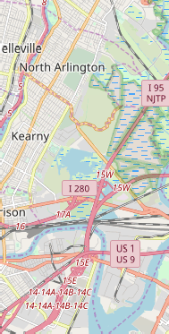
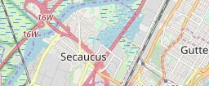
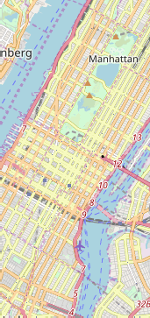
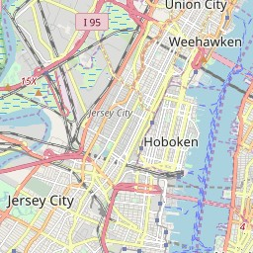
7/13/2019
Battle of Neighborhoods Report
In [29]:
# map subway stations
# create map of Manhattan using latitude and longitude values obtain previoulsy v
latitude=40.7308619 longitude=-73.9871558
map_mhsub1 = folium.Map(location=[latitude, longitude], zoom_start=12)
# add markers of subway locations to map
for lat, lng, label in zip(mhsub1['lat'], mhsub1['long'], mhsub1['sub_station']. label = folium.Popup(label, parse_html=True)
folium.RegularPolygonMarker( [lat, lng], number_of_sides=6, radius=6,
popup=label, color='red', fill_color='red', fill_opacity=2.5,
).add_to(map_mhsub1) map_mhsub1
Out[29]:
+
−
Leaflet (http://leafletjs.com)
Map of Manhattan showing places for rent and the subway locations nearby
Now, we can visualize the desirable rental places and their nearest subway station. Popups display rental address and monthly rental price and the subway station name.
Notice that the icon in the top-right corner is a "ruler" that allows to measure the distance from a rental place to an specific subway station

Slide 21
7/13/2019
Battle of Neighborhoods Report
In [30]:
mh_rent.head()
Out[30]: |  | Address | Area
 | 0 | West 105th Street | Upper West Side
 | 1 | East 97th Street | Upper East Side
 | 2 | West 105th Street | Upper West Side
 | 3 | CARMINE ST. | West Village
Price_per_ft2 Rooms
Area-
Rent_Price
Lat
Long
 |  | ft2
2.94 | 5 | 3400 | 10000 | 40.799771 | -73.966213
3.57 | 3 | 2100 | 7500 | 40.788585 | -73.955277
1.89 | 4 | 2800 | 5300 | 40.799771 | -73.966213
3.03 | 2 | 1650 | 5000 | 40.730523 | -74.001873
3.45 | 2 | 1450 | 5000 | 40.744118 | -73.995299
4
171 W 23RD
ST.
Chelsea

Slide 22
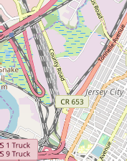
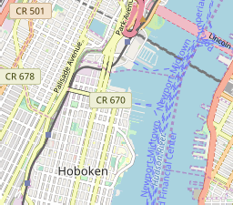
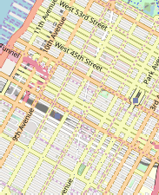


7/13/2019
Battle of Neighborhoods Report
In [31]:
# create map of Manhattan using latitude and longitude values from Nominatim
latitude= 40.7308619
longitude= -73.9871558
map_manhattan_rent = folium.Map(location=[latitude, longitude], zoom_start=13.3)
# add markers to map
for lat, lng, label in zip(mh_rent['Lat'], mh_rent['Long'],'$ ' + mh_rent['Rent_P label = folium.Popup(label, parse_html=True)
folium.CircleMarker( [lat, lng], radius=6, popup=label, color='blue', fill=True,
fill_color='#3186cc', fill_opacity=0.7,
parse_html=False).add_to(map_manhattan_rent)
# add markers of subway locations to map
for lat, lng, label in zip(mhsub1['lat'], mhsub1['long'], label = folium.Popup(label, parse_html=True) folium.RegularPolygonMarker(
[lat, lng], number_of_sides=6, radius=6, popup=label, color='red', fill_color='red', fill_opacity=2.5,
).add_to(map_manhattan_rent)
mhsub1['sub_station'].
# Adds tool to the top right
from folium.plugins import MeasureControl map_manhattan_rent.add_child(MeasureControl())
# Measurement ruler icon tool to measure distances in map
from folium.plugins import FloatImage
url = ('https://media.licdn.com/mpr/mpr/shrinknp_100_100/AAEAAQAAAAAAAAlgAAAAJGE3 FloatImage(url, bottom=5, left=85).add_to(map_manhattan_rent)
map_manhattan_rent
Out[31]:
+
−

Slide 23
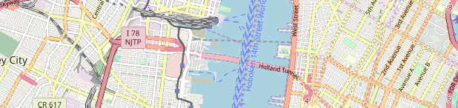


7/13/2019
Battle of Neighborhoods Report
float_image
Leaflet (http://leafletjs.com)
4. Results
Let's consolidate all the required inforamtion to make the apartment selection in one map for Manhattan with rental places, subway locations and cluster of venues
Red dots are Subway stations, Blue dots are apartments available for rent, Bubbles are the clusters of venues

Slide 24
7/13/2019
Battle of Neighborhoods Report
In [32]:
# create map of Manhattan using latitude and longitude values from Nominatim
latitude= 40.7308619
longitude= -73.9871558
map_mh_one = folium.Map(location=[latitude, longitude], zoom_start=13.3)
# add markers to map
for lat, lng, label in zip(mh_rent['Lat'], mh_rent['Long'],'$ ' + mh_rent['Rent_P label = folium.Popup(label, parse_html=True)
folium.CircleMarker( [lat, lng], radius=6, popup=label, color='blue', fill=True,
fill_color='#3186cc', fill_opacity=0.7, parse_html=False).add_to(map_mh_one)
# add markers of subway locations to map
for lat, lng, label in zip(mhsub1['lat'], mhsub1['long'], label = folium.Popup(label, parse_html=True) folium.RegularPolygonMarker(
[lat, lng], number_of_sides=6, radius=6, popup=label, color='red', fill_color='red', fill_opacity=2.5,
).add_to(map_mh_one)
mhsub1['sub_station'].
# set color scheme for the clusters
kclusters=5
x = np.arange(kclusters)
ys = [i+x+(i*x)**2 for i in range(kclusters)] colors_array = cm.rainbow(np.linspace(0, 1, len(ys))) rainbow = [colors.rgb2hex(i) for i in colors_array]
# add markers to the map
markers_colors = []
for lat, lon, poi, cluster in zip(manhattan_merged['Latitude'], manhattan_merged[ label = folium.Popup(str(poi) + ' Cluster ' + str(cluster), parse_html=True) folium.CircleMarker(
[lat, lon], radius=15, popup=label,
color=rainbow[cluster-1], fill=True, fill_color=rainbow[cluster-1],
fill_opacity=0.7).add_to(map_mh_one)
# Adds tool to the top right
from folium.plugins import MeasureControl map_mh_one.add_child(MeasureControl())

Slide 25
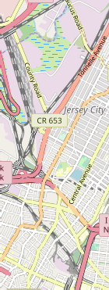
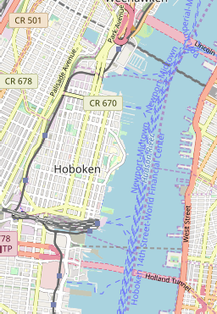
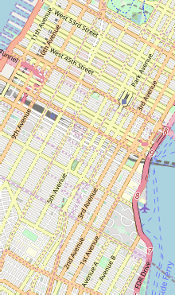



7/13/2019
Battle of Neighborhoods Report
# Measurement ruler icon tool to measure distances in map
from folium.plugins import FloatImage
url = ('https://media.licdn.com/mpr/mpr/shrinknp_100_100/AAEAAQAAAAAAAAlgAAAAJGE3 FloatImage(url, bottom=5, left=85).add_to(map_mh_one)
map_mh_one
Out[32]:
+
−
float_image
Leaflet (http://leafletjs.com)
After examining, I have chosen two locations that meet the requirements which will assess to make a choice
Apartment 1: 305 East 63rd Street in the Sutton Place Neighborhood and near 'subway 59th Street' station, Cluster # 2 Monthly rent : 7500 Dollars
Apartment 2: 19 Dutch Street in the Financial District Neighborhood and near 'Fulton Street Subway' station, Cluster # 3 Monthly rent : 6935 Dollars
Venues for Apartment 1 - Cluster 2

Slide 26
7/13/2019
Battle of Neighborhoods Report
In [33]:
## kk is the cluster number to explore
kk = 2
manhattan_merged.loc[manhattan_merged['Cluster Labels'] == kk, manhattan_merged.c
Out[33]:
 | 1st Most | 2nd Most | 3rd Most | 4th Most | 5th Most | 6th Most | 7th Mos
Neighborhood | Common | Common | Common | Common | Common | Common | Commo
 | Venue | Venue | Venue | Venue | Venue | Venue | Venu
0
Marble Hill
Coffee Shop
Discount
Store
Yoga Studio
Steakhouse
Supplement
Shop
Tennis Stadium
Sho Stor
1
Chinatown
Chinese Restaurant
Cocktail
Bar
Dim Sum Restaurant
American Restaurant
Vietnamese Restaurant
Salon / Barbershop
Noodl Hous
6
Central Harlem
African Restaurant
Seafood Restaurant
French Restaurant
American Restaurant
Cosmetics
Shop
Chinese Restaurant
Even Spac
9
Yorkville
Coffee Shop
Gym
Bar
Italian Restaurant
Sushi Restaurant
Pizza Place
Mexica Restauran
14
Clinton
Theater
Italian Restaurant
Coffee Shop
American Restaurant
Gym / Fitness Center
Hotel
Wine Sho
23
Soho
Clothing
Store
Boutique
Women's
Store
Shoe Store
Men's Store
Furniture /
Home Store
Italia Restauran
26
Morningside
Heights
Coffee Shop
American Restaurant
Park
Bookstore
Pizza Place
Sandwich
Place
Burge Join
34
Sutton Place
Gym / Fitness Center
Italian Restaurant
Furniture /
Home Store
Indian Restaurant
Dessert
Shop
American Restaurant
Baker
39
Hudson Yards
Coffee Shop
Italian Restaurant
Hotel
Theater
American Restaurant
Café
Gym Fitnes Cente
Venues for Apartment 2 - Cluster 3

Slide 27
7/13/2019
Battle of Neighborhoods Report
In [34]:
## kk is the cluster number to explore
kk = 3
manhattan_merged.loc[manhattan_merged['Cluster Labels'] == kk, manhattan_merged.c
Out[34]:
 | 1st Most | 2nd Most | 3rd Most | 4th Most | 5th Most | 6th Most | 7th Mos
Neighborhood | Common | Common | Common | Common | Common | Common | Commo
 | Venue | Venue | Venue | Venue | Venue | Venue | Venu
3
Inwood
Mexican Restaurant
Lounge
Pizza Place
Café
Wine Bar
Bakery
America Restauran
5
Manhattanville
Deli / Bodega
Italian Restaurant
Seafood Restaurant
Mexican Restaurant
Sushi Restaurant
Beer Garden
Coffe Sho
10
Lenox Hill
Sushi Restaurant
Italian Restaurant
Coffee Shop
Gym / Fitness Center
Pizza Place
Burger
Deli
 | Joint | Bodeg
Indian | Coffee | Cosmetic
Restaurant | Shop | Sho
Coffee | Salon / | Burge
Shop | Barbershop | Join
Nightclub | Theater | Art Galler
12
Upper West
Side
Italian Restaurant
Bar
Bakery
Vegetarian
/ Vegan Restaurant
16
Murray Hill
Sandwich
Place
Hotel
Japanese Restaurant
Gym / Fitness Center
17
Chelsea
Coffee Shop
Italian Restaurant
Ice Cream
Shop
Bakery
18
Greenwich
Village
Italian Restaurant
Sushi Restaurant
French Restaurant
Clothing
Store
Chinese Restaurant
Café
India Restauran
27
Gramercy
Italian Restaurant
Restaurant
Thrift / Vintage Store
Cocktail
Bar
Bagel Shop
Coffee Shop
Pizz Plac
29
Financial District
Coffee Shop
Hotel
Gym Wine Shop
Steakhouse
Bar
Italia Restauran
31
Noho
Italian Restaurant
French Restaurant
Cocktail
Bar
Gift Shop
Bookstore
Grocery
Store
Mexica Restauran
32
Civic Center
Gym / Fitness Center
Bakery
Italian Restaurant
Cocktail
Bar
French Restaurant
Sandwich
Place
Coffe Sho
35
Turtle Bay
Italian Restaurant
Coffee Shop
Steakhouse
Wine Bar
Sushi Restaurant
Hotel
Noodl Hous
36
Tudor City
Café
Park
Pizza Place
Mexican Restaurant
Greek Restaurant
Sushi Restaurant
Hote
38
Flatiron
Italian Restaurant
American Restaurant
Gym
Gym / Fitness Center
Yoga Studio
Vegetarian
/ Vegan Restaurant
Baker
Apartment Selection
Using the "one map" above, I was able to explore all possibilities since the popups provide the information needed for a good decision.

Slide 28
7/13/2019
Battle of Neighborhoods Report
Apartment 1 rent cost is US7500 slightly above the US7000 budget. Apartment 1 is located 400 meters from subway station at 59th Street and work place ( Park Ave and 53rd) is another 600 meters way. I can walk to work place and use subway for other places aroung. Venues for this apt are as of Cluster 2 and it is located in a fine district in the East side of Manhattan.
Apartment 2 rent cost is US6935, just under the US7000 budget. Apartment 2 is located 60 meters from subway station at Fulton Street, but I will have to ride the subway daily to work , possibly 40-60 min ride. Venues for this apt are as of Cluster 3.
Based on current Singapore venues, I feel that Cluster 2 type of venues is a closer resemblance to my current place. That means that Apartment 1 is a better choice since the extra monthly rent is worth the conveniences it provides.
5. DISCUSSION
I am impressed with the overall organization, content and lab works presented during the Coursera IBM Certification Course.
I feel this Capstone project was a great opportunity to practice and apply the Data Science tools and methodologies learned.
I feel I have acquired skills to become a professional Data Scientist and will continue exploring.
6.CONCLUSION
This project has given me insight on how to solve a real life problem.
The mapping with Folium is a very powerful technique to consolidate information, analyze and make a decision confidently.

